Slide 1
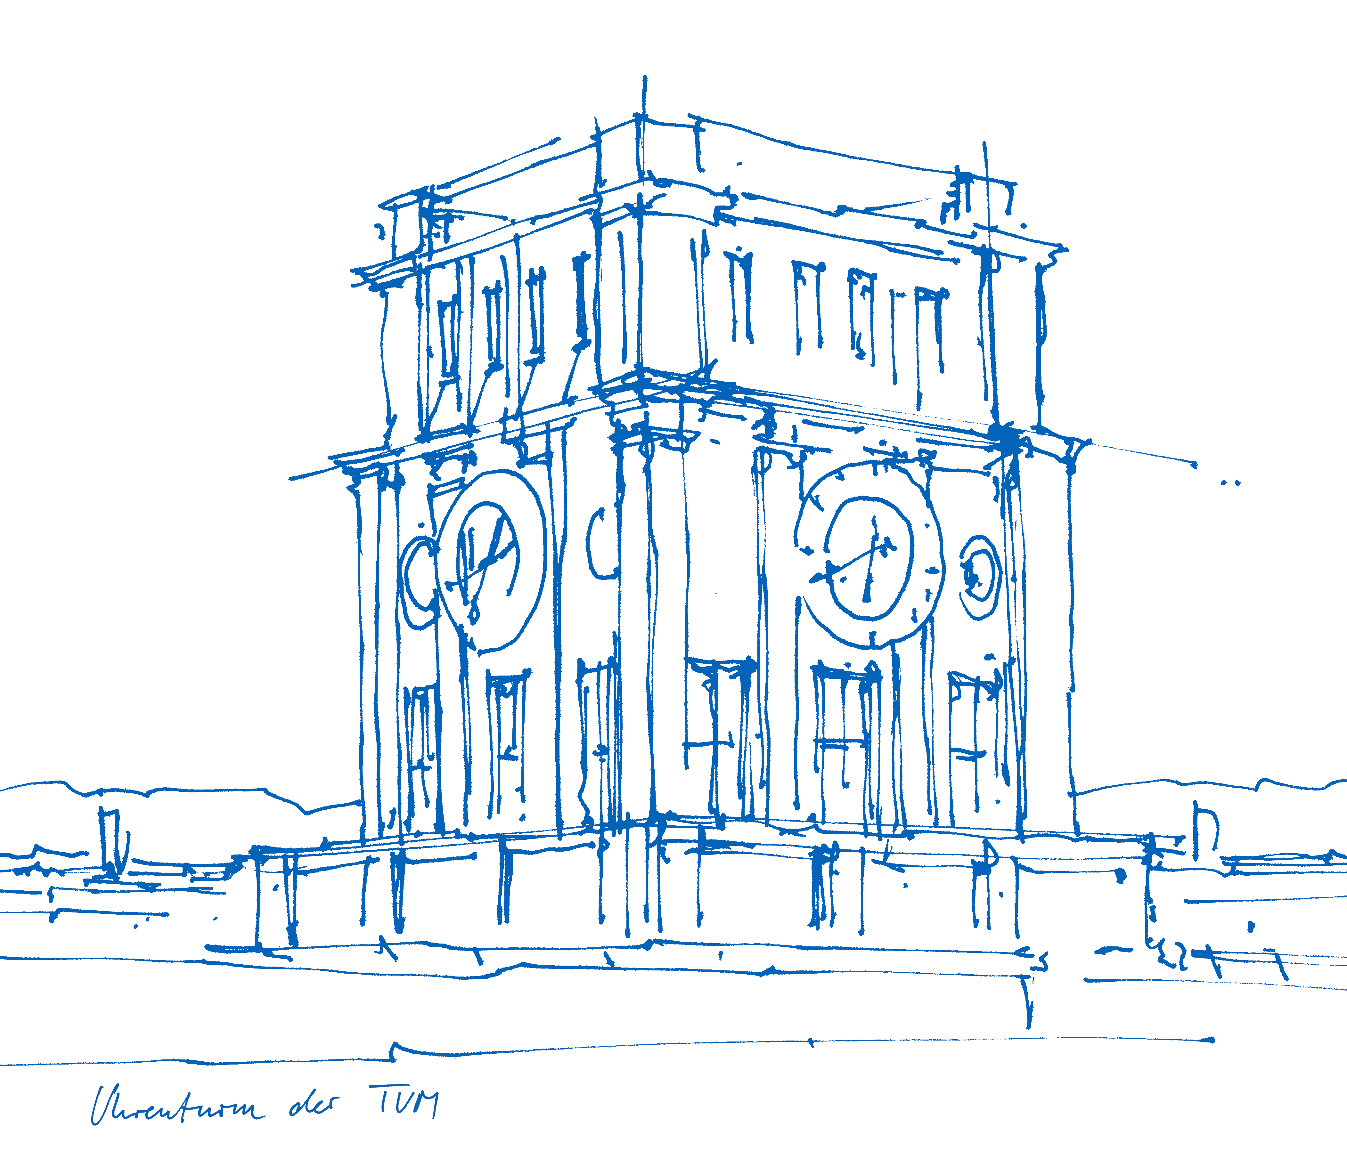
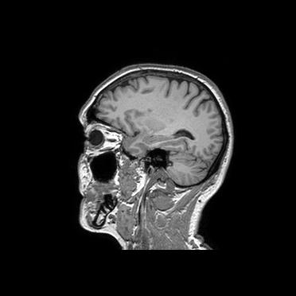
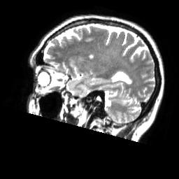
Machine Learning in Medical Imaging SS16
Project Presentation: U-Net Implementation
Claus Meschede, Leonard Rychly
Technische Universität München
Fakultät für Informatik
Chair for Computer Aided Medical Procedures & Augmented Reality
München, July 18, 2016

Slide 2
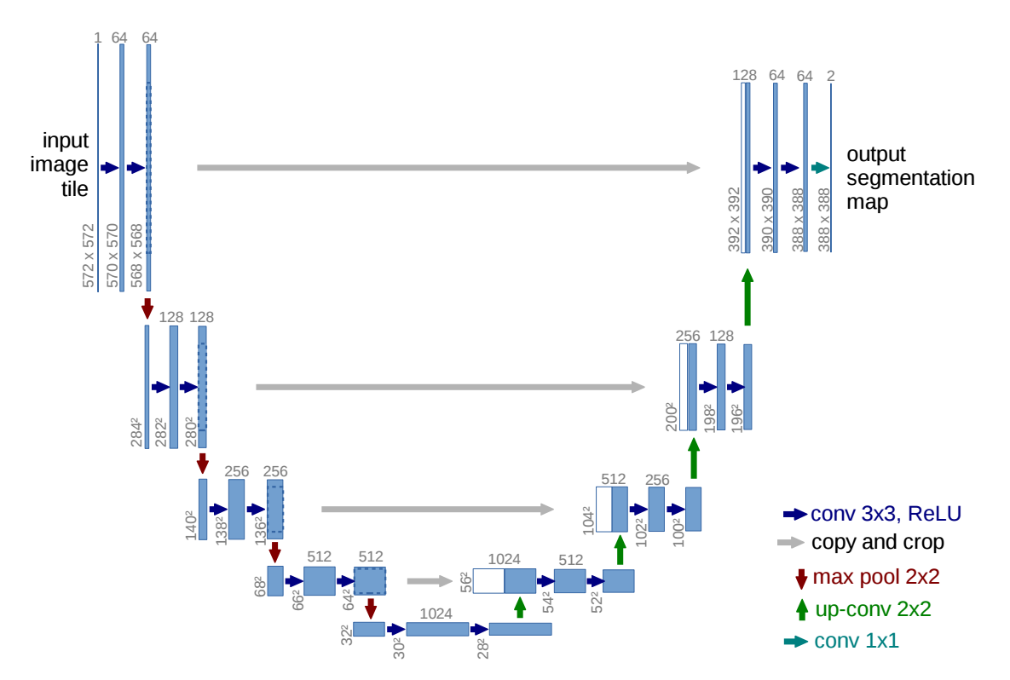
U-Net Architecture [Ronneberger et al., 2015]
Main feature: skip connections for reusing finer feature maps.
Used for medical image segmentation.

Slide 3
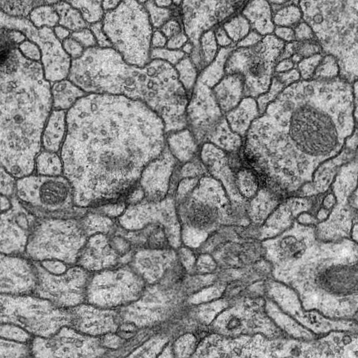
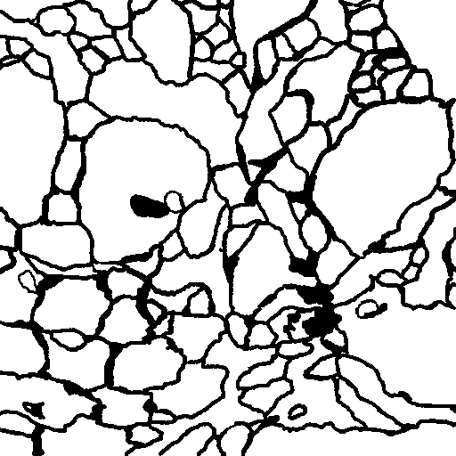
U-Net: Biomedical Image Segmentation
Main feature: skip connections for reusing finer feature maps.
Used for medical image segmentation.

Slide 4
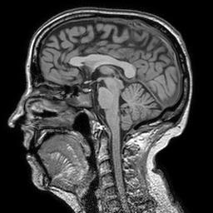
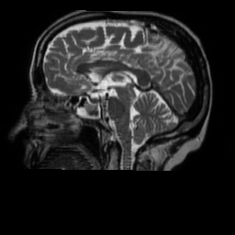
Idea
Adapt U-Net Architecture to predict one modality given another.
Raw volumetric data is available (Brain MRI)

Slide 5
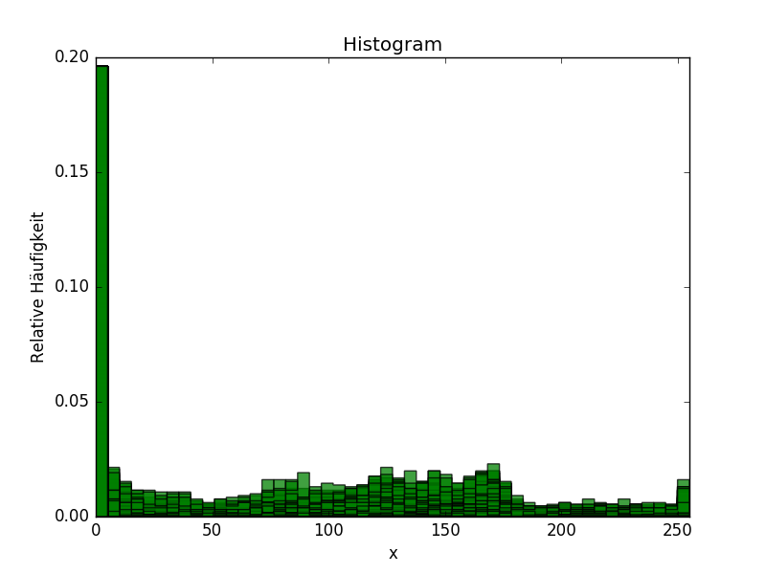
Image Generation
Generate 2D Images from raw volumetric data.
Normalize gray scale images.

Slide 6
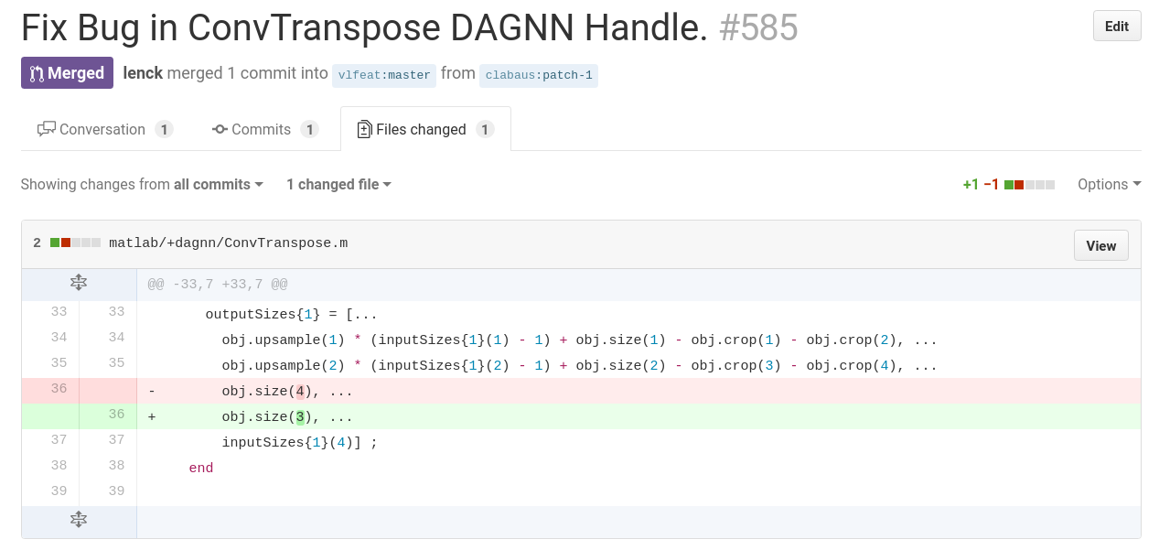
Issue #1

Slide 7
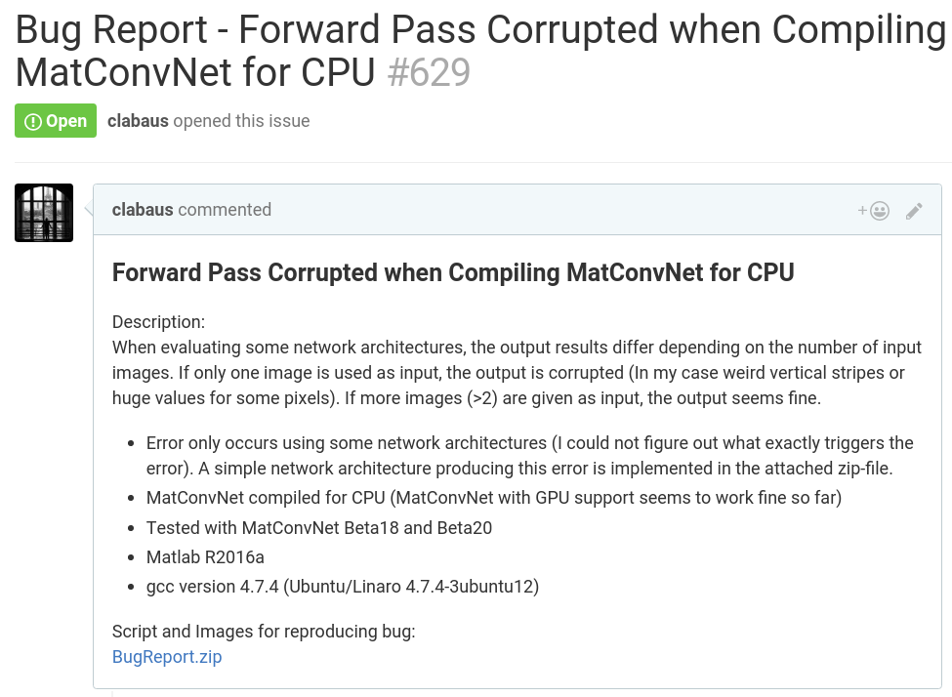
Issue #2

Slide 8
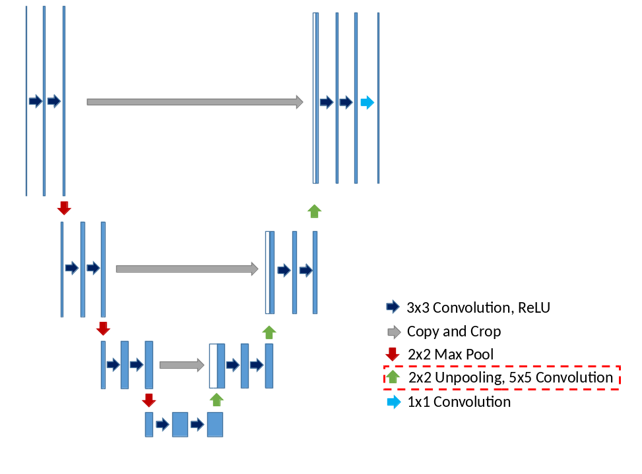
U-Net Implentation with Unpooling

Slide 9
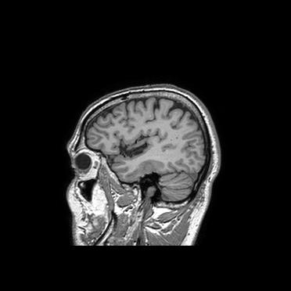
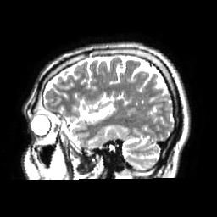
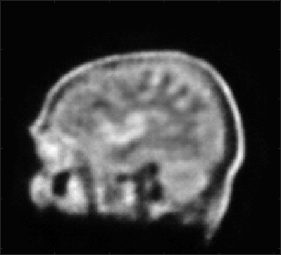
U-Net Implentation with Unpooling – Results
Test Image
Target Image
Output Image
# of images: 8000
# of epochs: 22
Learning rate: 1e-7
Weight decay: 0.01
Momentum: 0.9

Slide 10
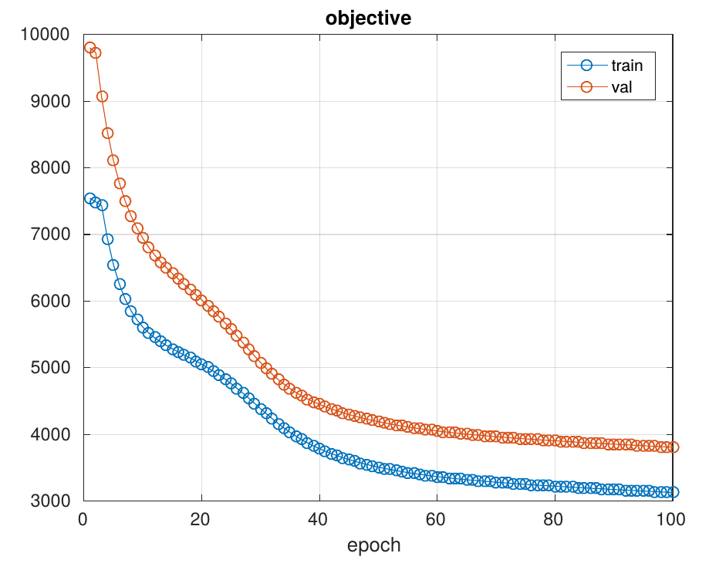
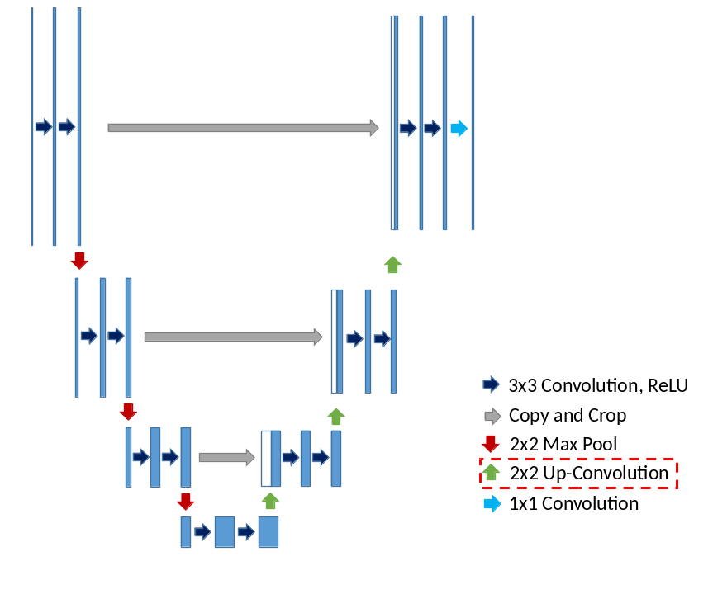
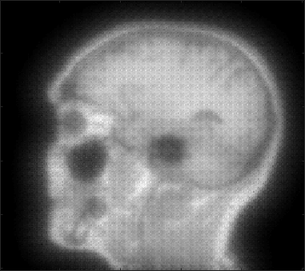
U-Net Implentations with Up-Convolutions
# of images: 15
Not trained with all available images yet!

Slide 11
Summary
What we have learned:
Using state-of-the-art software in development can be cumbersome:
→ Importance of systematic troubleshooting
Implementing CNNs
Training CNNs
Optimize learning parameters
Conclusion:
U-Net capable of roughly predicting the target modality.
Further testing needed for performance evaluation …
Bigger training set
Up-Convolutions ↔ Unpooling
Increasing depth of U-Net
Convolutions using padding
Cut input images to output shape
→ Compare performance of U-Net with other CNNs

